Slide 1



Noninvasive Glucose Monitoring Using Polarized Light
Tianxing Li†,#, Derek Bai†, Temiloluwa Prioleau†, Nam Bui‡, Tam Vu‡,§, and Xia Zhou†
†Department of Computer Science, Dartmouth College, Hanover, NH
#Department of Computer Science, UMass Amherst, Amherst, MA
‡Department of Computer Science, University of Colorado Boulder, Boulder, CO
§Department of Computer Science, Oxford University, UK

Slide 2
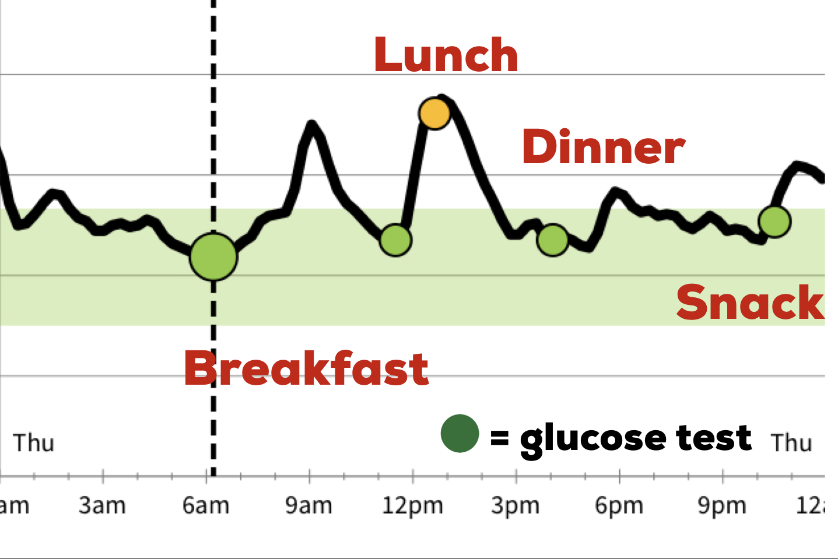
The Importance Of Glucose Monitoring
30+ million Americans have diabetes
Glucose monitoring can manage diabetes conditions
  Require > 3 times a day
160
130
100
70
Normal: 70-140 mg/dl
High: > 140 mg/dl
Low: < 70 mg/dl
mg/dl

Slide 3
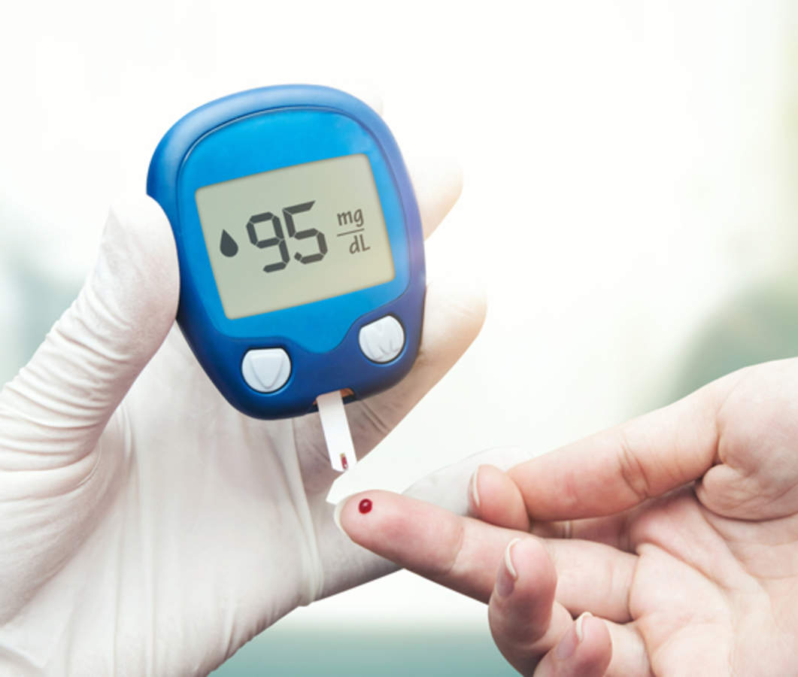
Existing Method #1: Finger Pricking
☹ Painful, invasive

Slide 4
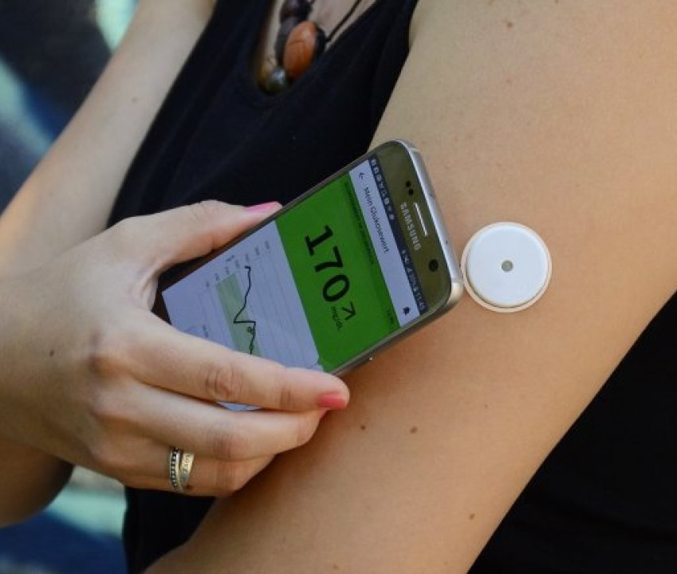
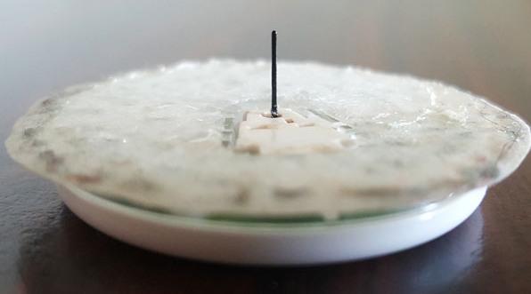
Existing method #2: Continuous Glucose Monitoring (CGM)
☹ Invasive needle

Slide 5
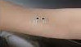
Existing Noninvasive Glucose Monitoring
Skin irritation
Environmental factors

Slide 6
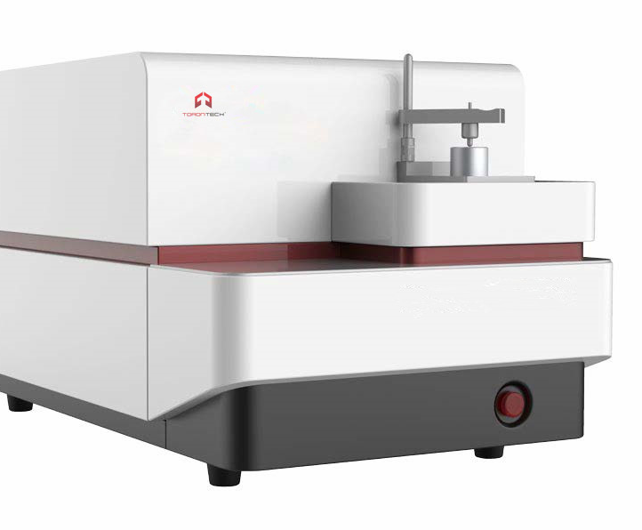
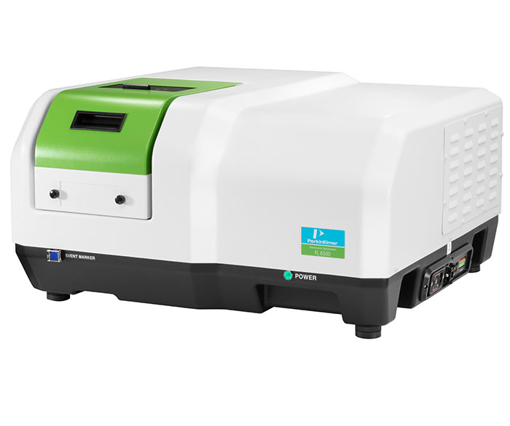
Optical Noninvasive Glucose Monitoring
Light absorption
Light polarization
Raman spectroscopy
Fluorescence
We need a noninvasive, accurate, and low-cost glucose monitoring system!
Expensive and bulky
Lacking clinical evaluations

Slide 7
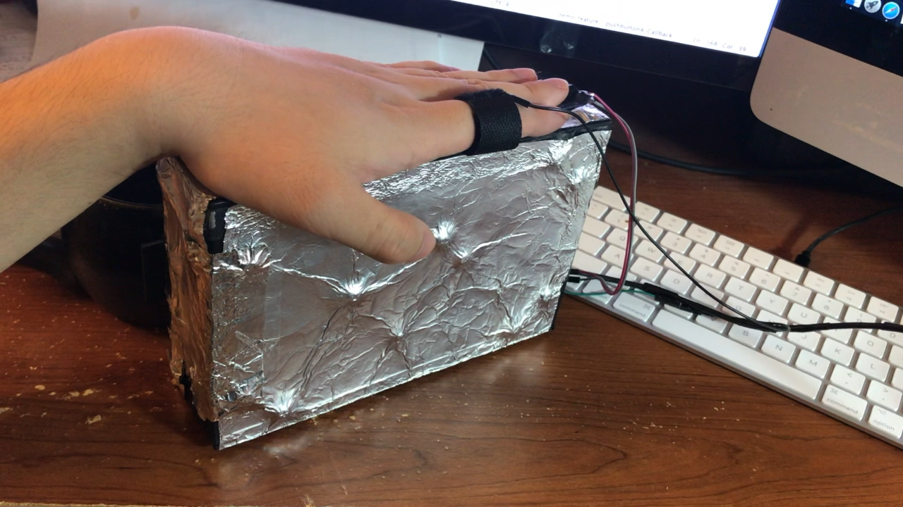
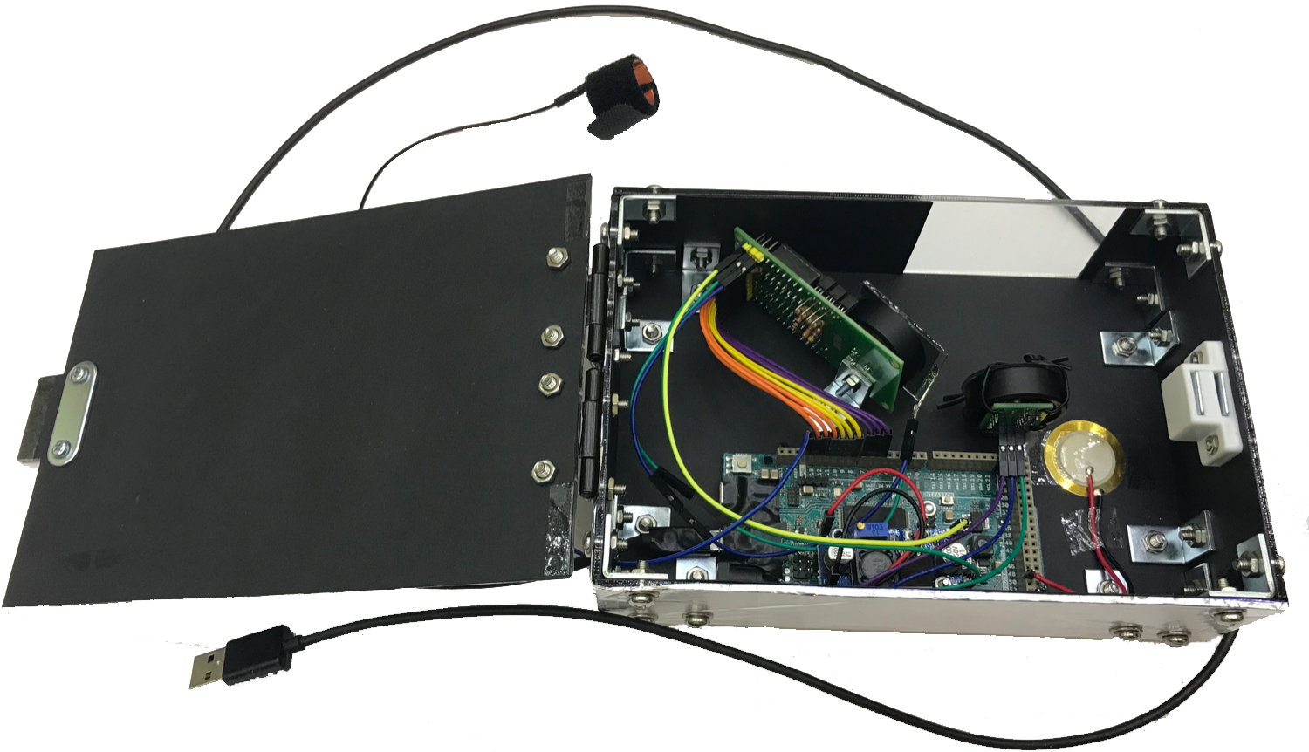
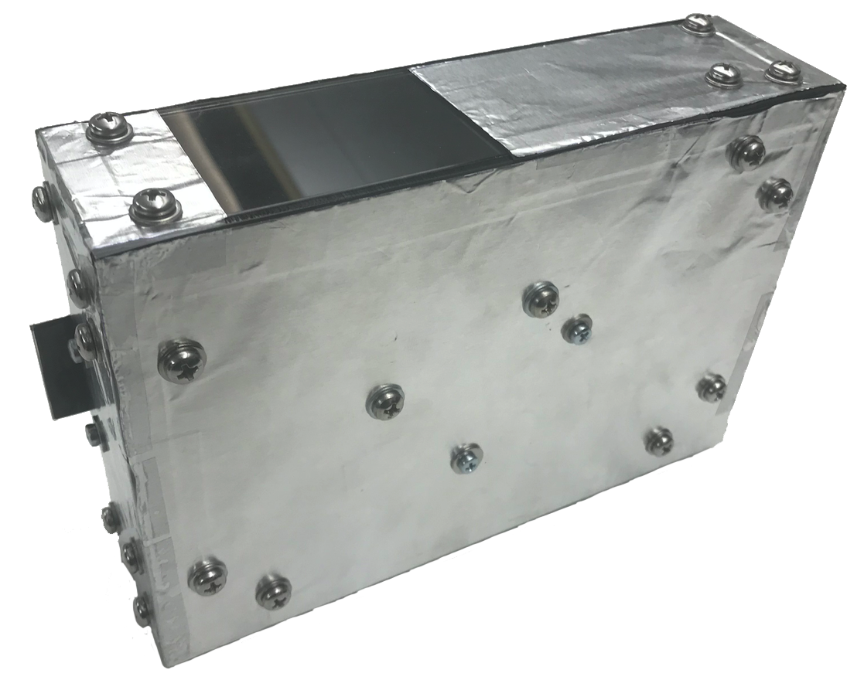
Prototype In Use
17 cm
5 cm
Sensing area
10 cm

Slide 8
Outline
Motivation & Related work
Rationale
Challenge & System Design
Prototype Evaluation
Discussion

Slide 9
Rationale
Glucose is an optically active (chiral) molecule
  $α$: Optical rotation
  R: Rotatory power of the molecular species
  C: Glucose concentrate
  L: Optical path
Glucose molecules
Difficult to compute in vivo
Output: Linear
polarized light
Input: Linear
polarized light
$α=R\left(λ,T\right) ∙$ C $∙$ L

Slide 10
Challenges
#1: Skin scattering
Polarized light
~5% Specular reflected light
~2% Polarized light
~40% Randomly polarized light
Interstitial fluid (ISF)
Skin
~53% Absorbed

Slide 11
Outline
Motivation & Related work
Rationale
Challenge & System Design
  #1 Sensing changes in Light polarization
Prototype Evaluation
Discussion

Slide 12
Sensing Changes In Light Polarization
Polarized light
P1
Laser diode
Photodiode
Scattered light
P2
Linear polarizing film (0°)
Linear polarizing film (90°)
Liquid crystal
Specular Reflected Light
Epidermis (avg. 0.1 mm)
$I_{per}$ = P1 + 0.5 x P2
-
=
P1
Dermis (avg. 2 mm)
$I_{par}$ = 0.5 x P2

Slide 13
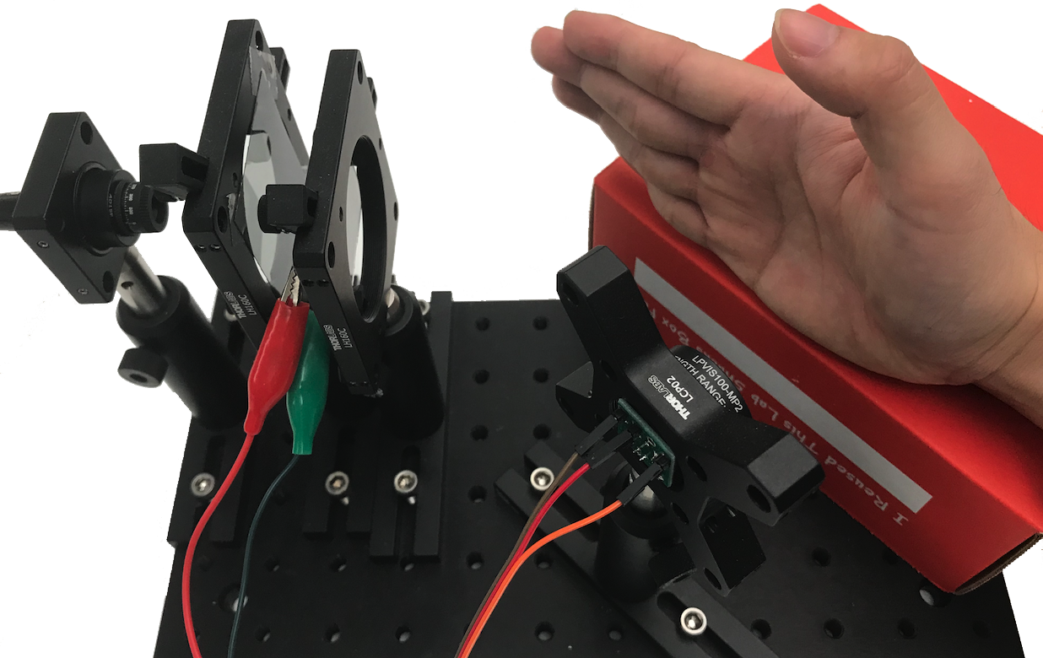
Experiment Setup
Liner polarizing film (0°)
Liquid crystal
Diffuser
Red laser diode
Photodiode
Liner polarizing film (90°)

Slide 14
Results
${ I}_{per}$ = P1 + 0.5 x P2
$I_{par}$ = 0.5 x P2
$Feature value=I_{per} − I_{par}$
R = 0.86, p < 0.05
Meal

Slide 15
Challenges
#1: Skin scattering
#2: Confound factors
#3: User diversity
Lactate molecule
Elastin fiber

Slide 16
Outline
Motivation & Related work
Rationale
Challenge & System Design
  #1 Sensing changes in Light polarization
  #2 Multiple Wavelengths & Intensity Levels
Prototype Evaluation
Discussion

Slide 17
Multiple Wavelengths & Intensity Levels
NIR 880 nm
Green 520 nm
UV 350 nm
Red 658 nm
Blue 450 nm
mm
0
Epidermis
15%–35% ISF
1
Dermis
35%–45% ISF
2
<20% ISF
3

Slide 18
Results
RGB lights with 7 intensity levels （21 features）
ID | Age | Gender | Race | R
 |  |  |  | Single W&I | Multi W&I
1 | 31 | M | Asian | 0.86 | 0.86
2 | 23 | M | Asian | 0.64 | 0.83
3 | 18 | M | Asian | 0.6 | 0.78
4 | 24 | M | Asian | 0.63 | 0.81
5 | 23 | F | Asian | 0.65 | 0.74
6 | 23 | M | White | 0.71 | 0.75
7 | 25 | M | African American | 0.46 | 0.78
8 | 24 | M | American Indian | 0.51 | 0.74
9 | 33 | F | Asian | 0.48 | 0.75

Slide 19
Outline
Motivation & Related work
Rationale
Challenge & System Design
  #1 Sensing changes in Light polarization
  #2 Multiple Wavelengths & Intensity Levels
  #3 Generic Learning Model Using Boost Regression Trees
Prototype Evaluation
Discussion

Slide 20
Generic Learning Model using Boost Regression Trees
#3: Generic learning model
Feature selection
⅓ Features
Offline training
Features
Imbalanced dataset
21 Sensing features
6 demographic
  Age
  Gender
  Skin tone
  Type of diabetes
  Race
  Type of CGM sensors
Features are ranked by importance score using boosted tree
Collect training data from 50 participants
Apply Xgboost to construct boosted trees.

Slide 21
Outline
Motivation & Related work
Rationale
Challenge & System Design
Prototype Evaluation
Discussion

Slide 22
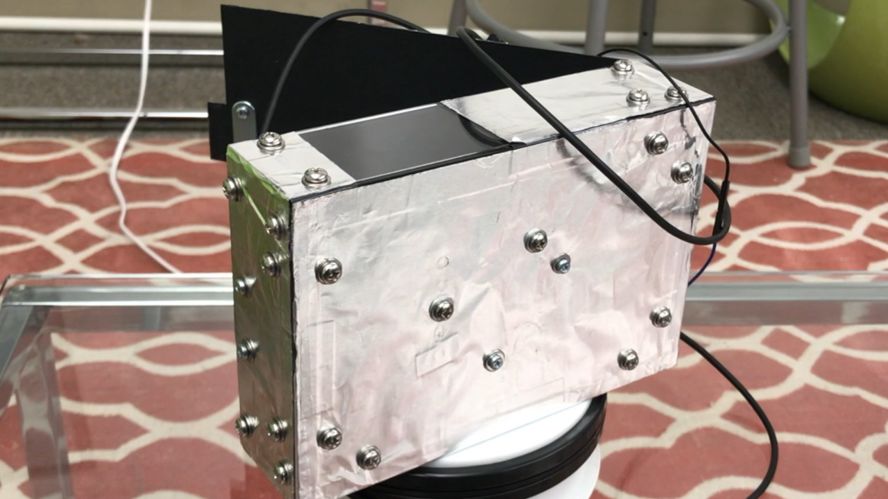
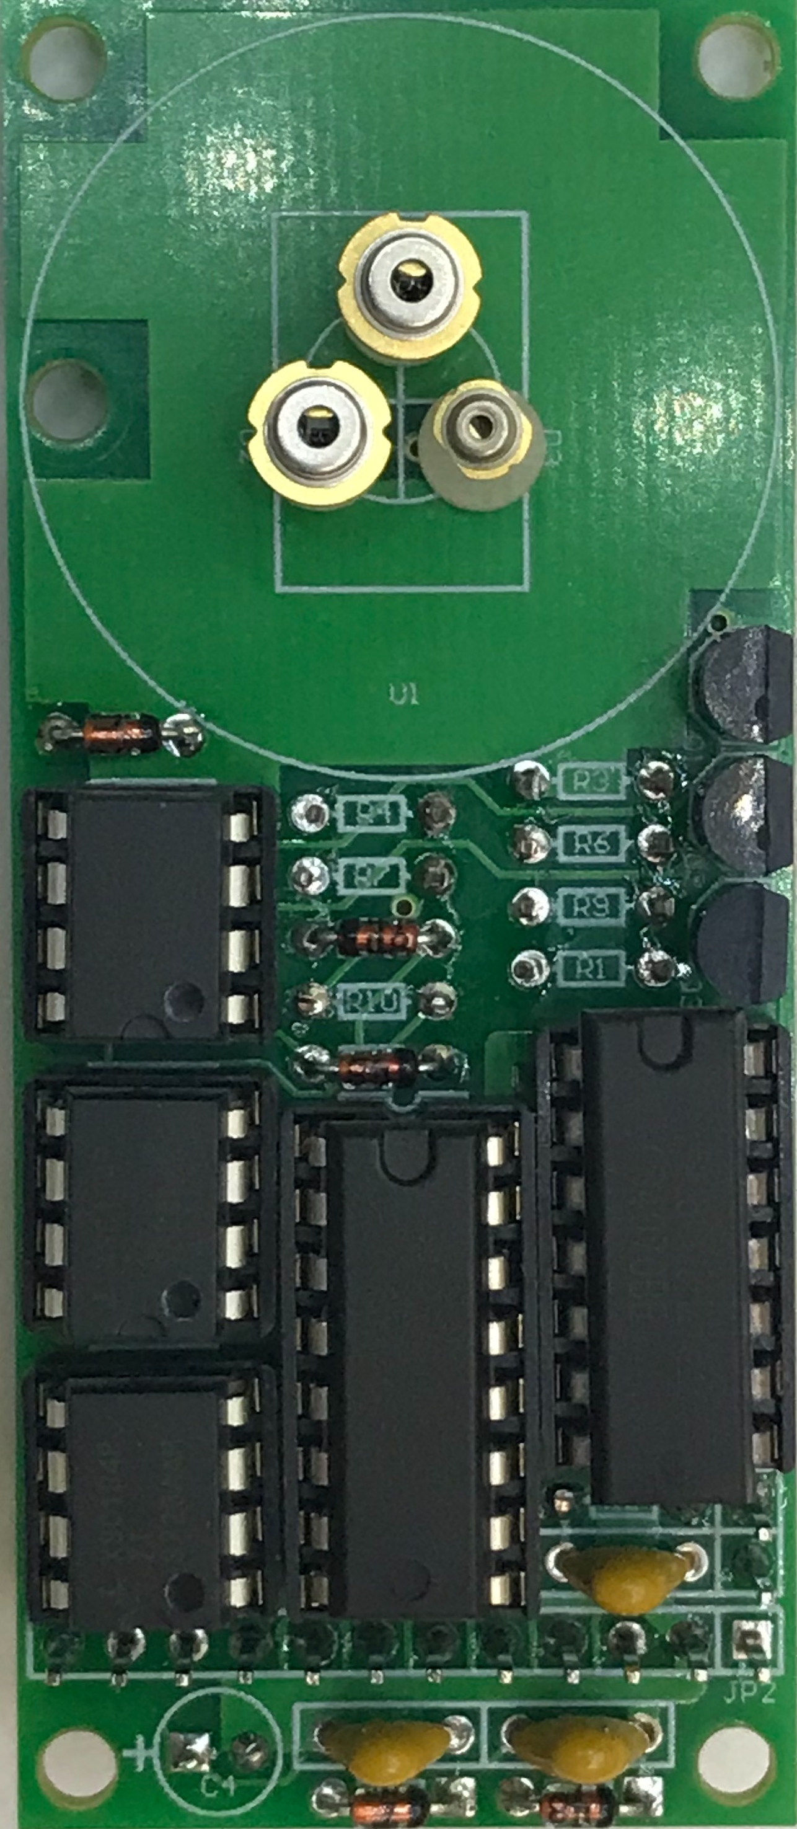
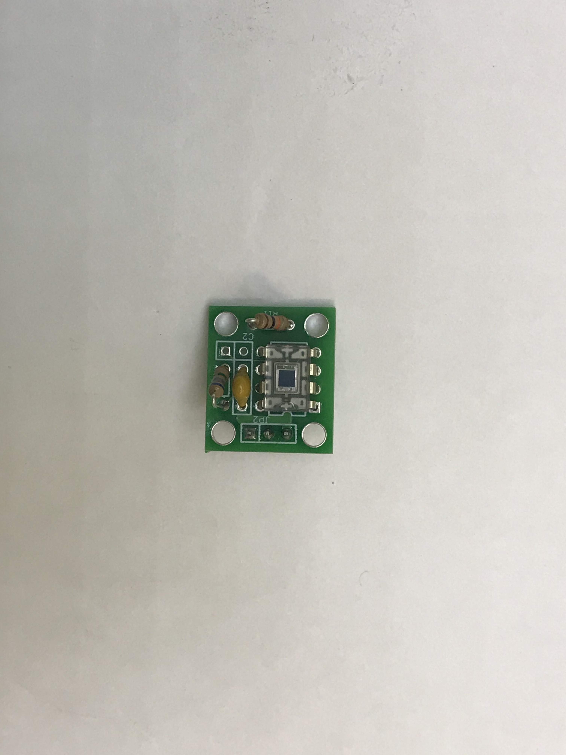
Laser diodes
5 cm
Sensing area
Photodiode
10 cm
17 cm
Speaker

Slide 23
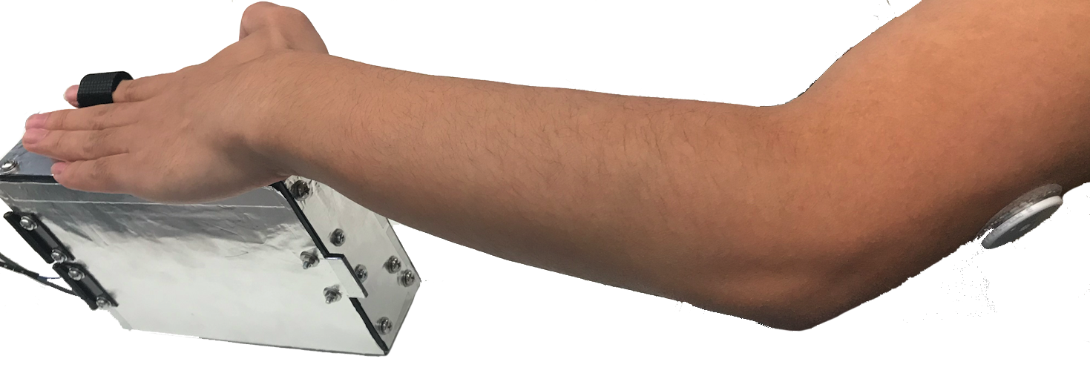
Experiment Setup
Freestyle Libre sensor

Slide 24
Study Participants
50 participants (41 patients and 9 healthy people)

Slide 25
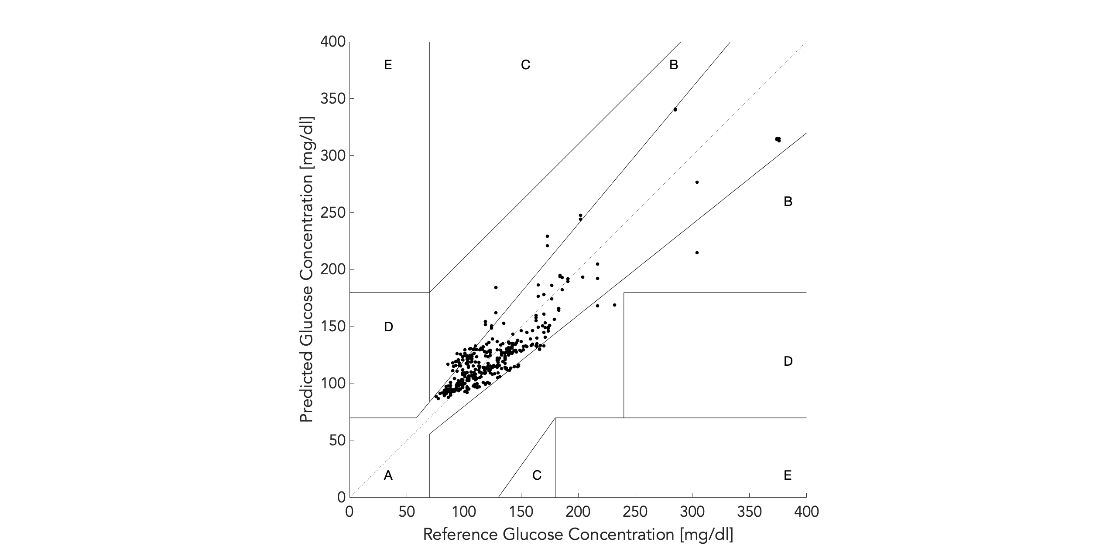
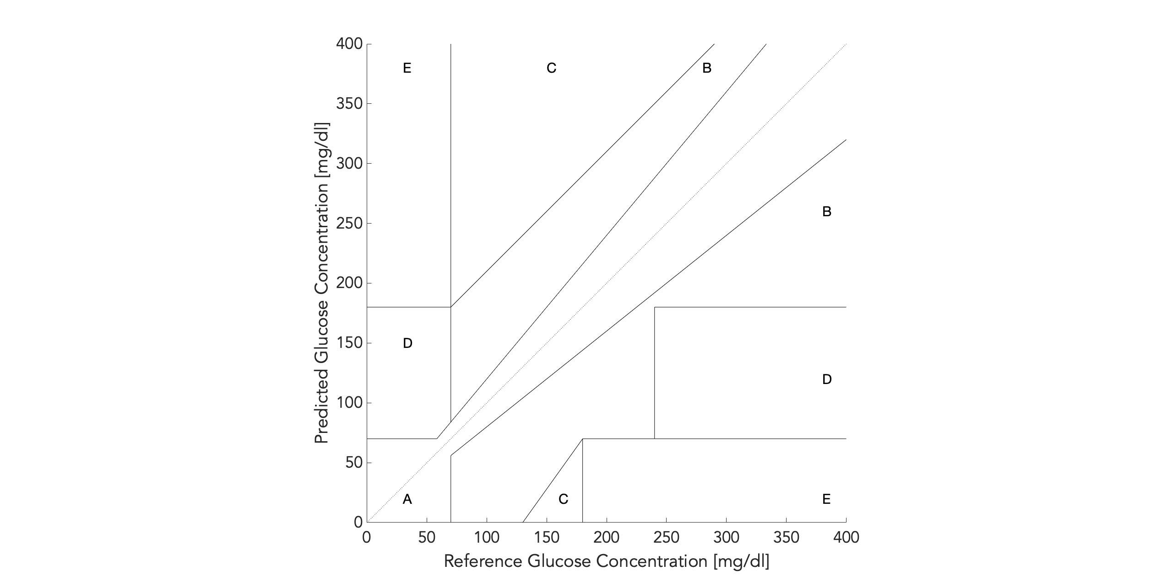
Clarke Error Grid Analysis
89% of the results are within zone A

Slide 26
Outline
Motivation & Related work
Rationale
Challenge & System Design
Prototype Evaluation
Discussion

Slide 27
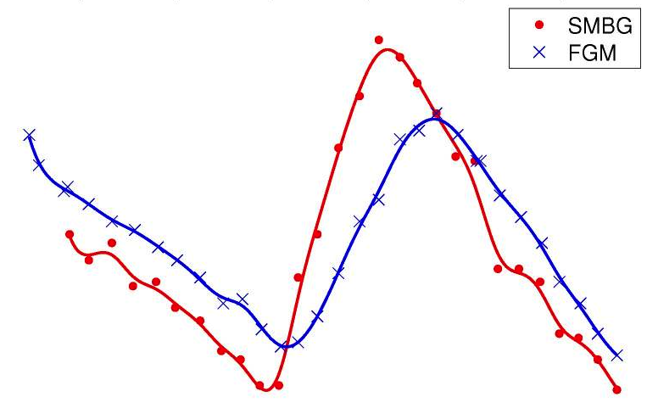

Discussion
Ground truth
  CGM sensors vs. Finger prick blood test
Accuracy/Robustness improvement
  More diverse participants

Slide 28
Noninvasive Glucose Monitoring Using Polarized Light
Tianxing Li†,#, Derek Bai†, Temiloluwa Prioleau†, Nam Bui‡, Tam Vu‡,§, and Xia Zhou†
†Department of Computer Science, Dartmouth College, Hanover, NH
#Department of Computer Science, UMass Amherst, Amherst, MA
‡Department of Computer Science, University of Colorado Boulder, Boulder, CO
§Department of Computer Science, Oxford University, UK

Slide 29
Results
R = 0.65
Meal
User 2 (23 years old female Asian)
R = 0.6
Meal
User 3 (18 years old male Asian)

Slide 30
Practical Considerations

Slide 31
Practical Considerations

Slide 32
User Diversity

